Slide 1

Employee payroll Management

Slide 2

BATCH -03 FRONTEND AND BACKEND
KAMATAM MANIKANTA -2604294
KATAKAM HEMANTH KUMAR -260566
KAUSHAL KUMAR -2604587
KAVIYA GOPALAKRISHANAN -2604963
MARSHAL X -2604307
MATHAN P -2604070

Slide 3

CONTENTS
1. Introduction
2. Objective
3. Tools & Languages Used
4. Features of Employee Payroll Management System
5. Advantages
6. App Flow
7. E-R Diagram
8. Screen Shots Of Output and details
9. Conclusion

Slide 4

Introduction
The Employee Payroll Management System (EPMS) is An Internet-based Java Application That Automates The Working Of A Company Or Work Center That Manage And Maintain Records Of The Employees In The Different Department.
However, manual payroll management can be time-consuming, prone to errors, and inefficient, especially as the company grows.
An EPMS provides a centralized platform where all payroll-related activities are handled efficiently, It integrates various functions such as , tracking working hours, and generating pay slips, making the entire payroll process more transparent and manageable.

Slide 5

objective
The Primary objective of the design is to deliver the requirement as delivered by the feasibility report. There are some objective we kept in mind.
Practically : The system is quite stable and can be operated by the Employees with average intelligence.
Efficiency : We tried to involve accuracy, timeliness and comprehensiveness of system output.

Slide 6

FRONTEND
TOOLS AND LANGUAGES
BACKEND
Visual Studio
Angular
HTML
CSS
BOOTSTRAP
Spring Tool Suite
My SQL
Hibernate

Slide 7

Features of employee payroll management system
Easy to use.
It is completely secure.
This system is easily compatible with most of the web browsers.
Admin can view all the records whenever necessary with ease.

Slide 8

advantages
Helps the employee easy way to access their data.
The information related to employee can be added , edited, removed easily.
Store the end-to-end data of the employees

Slide 9

APP FLOW
START
ADMIN
EMPLOYEE
LOGIN
NO
REGISTER
NO
LOGIN
Add Employee
Salary Details
Salary List
View Attendance
Leave List
Timesheet
Attendance list
Schedule
Schedule List
Leave
Timesheet List
LOGOUT

Slide 10
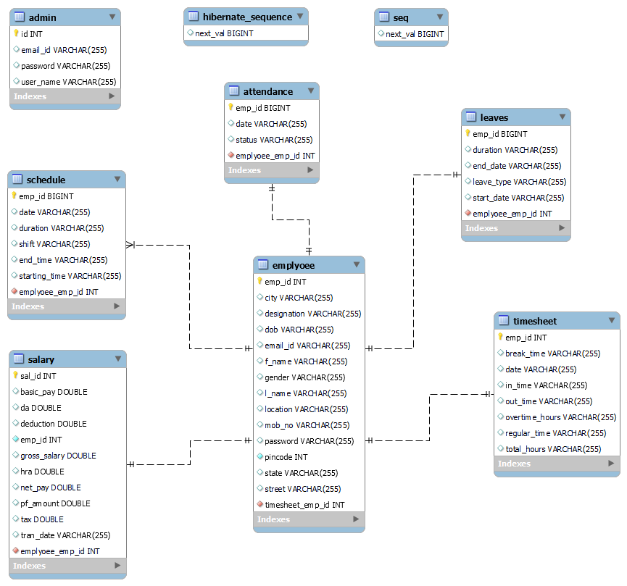
ER – DIAGRAM
Admin
Employee
Schedule
Attendance
Salary
Leaves
Timesheet

Slide 11
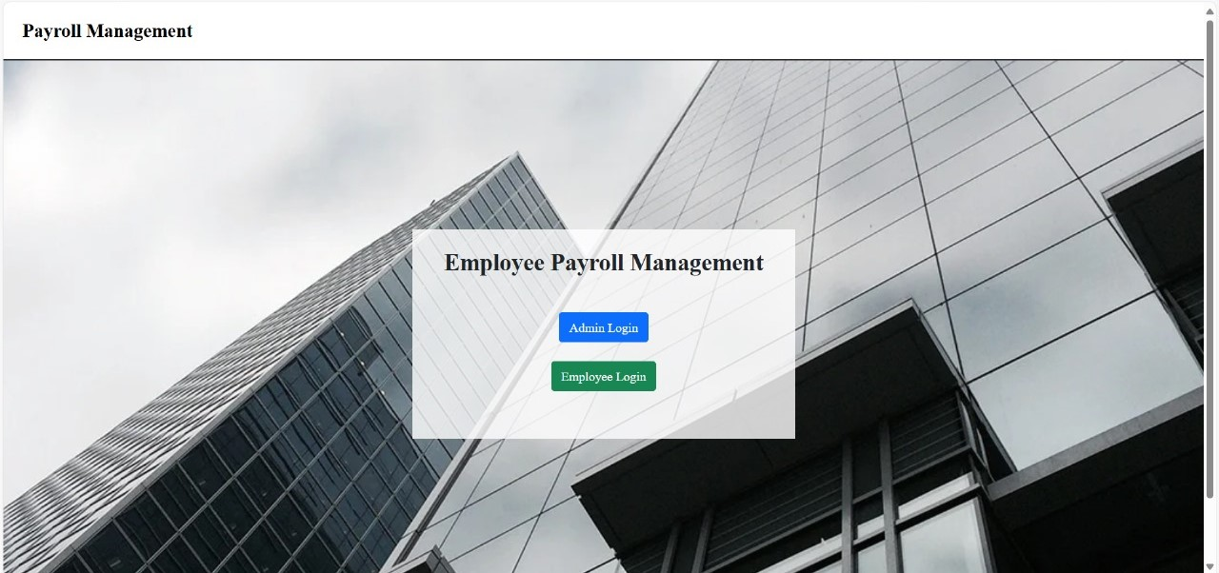

Slide 12
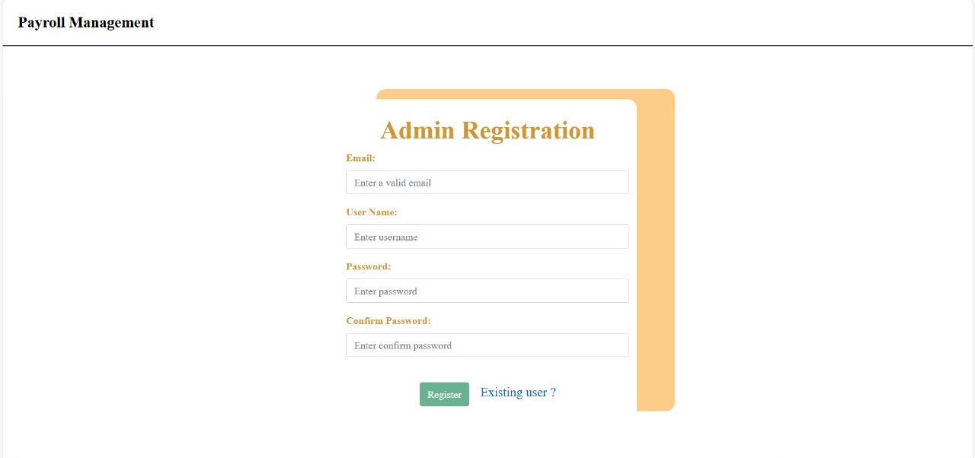

Slide 13
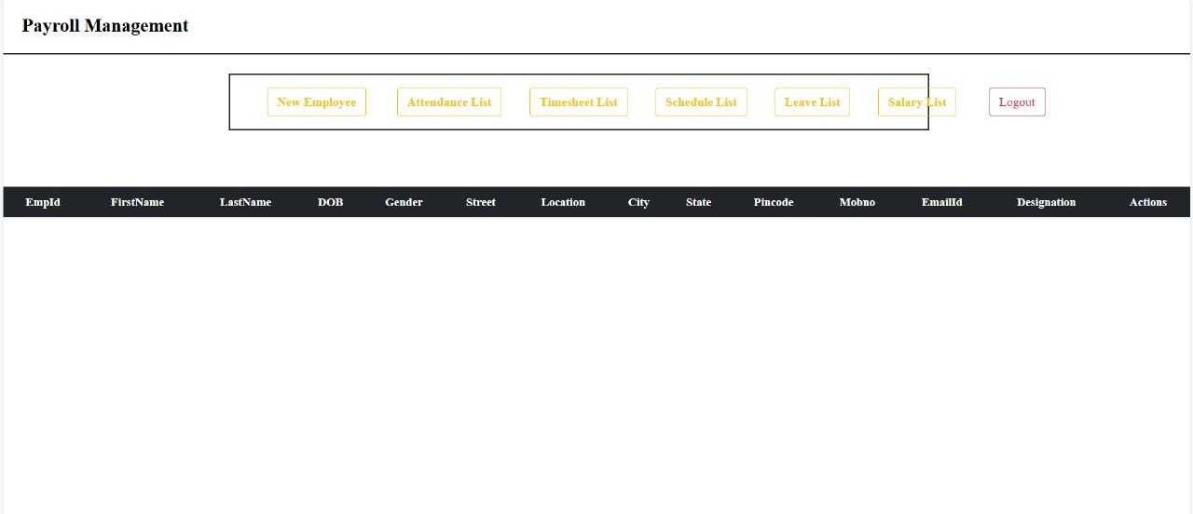

Slide 14

Add /edit /delete and view employee
Add : Expanding your team? Adding new members is straightforward—just fill in the details.
Edit : Roles change? You can easily update employee information to reflect their current roles.
Delete : If circumstances change, removing employee records is hassle-free, keeping everything accurate.
View : Get a quick overview of your workforce to stay organized and manage effectively.

Slide 15
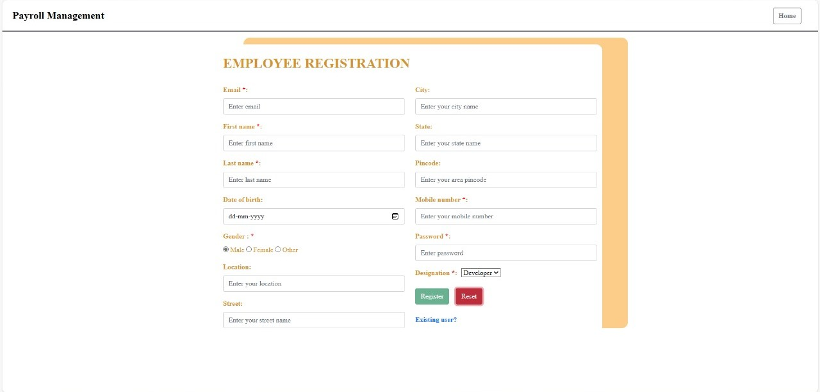

Slide 16

Mark/edit and delete attendance of employee
Mark: Recording employee attendance is a breeze. Just input the dates they worked, and you're good to go!
Edit: Made a mistake in the attendance log? No problem! Easily edit attendance records to match the accurate hours.
Delete: Things change? You can remove attendance entries hassle-free, keeping records spot on.

Slide 17
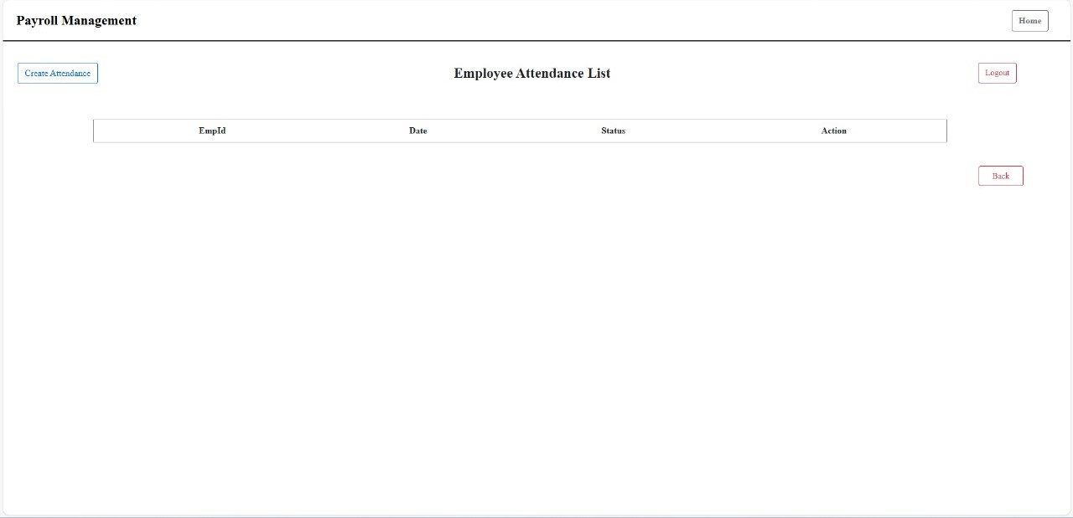

Slide 18
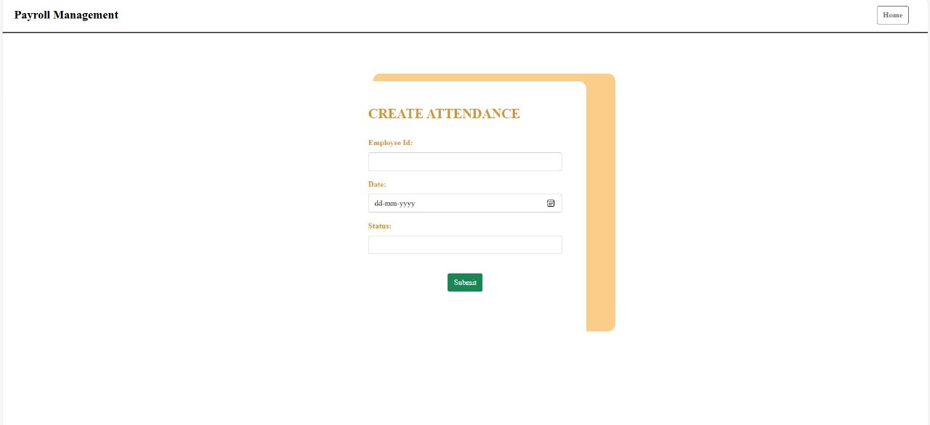

Slide 19

CREATE/edit and delete TIMESHEET
Create: Recording employee Check in Time and Out Time. And Counting the total Hours Worked
Update: Made a mistake in the timesheet? No problem! Easily update timesheet records to match the accurate hours.
Delete: Things change? You can remove timesheet entries hassle-free, keeping records spot on.

Slide 20
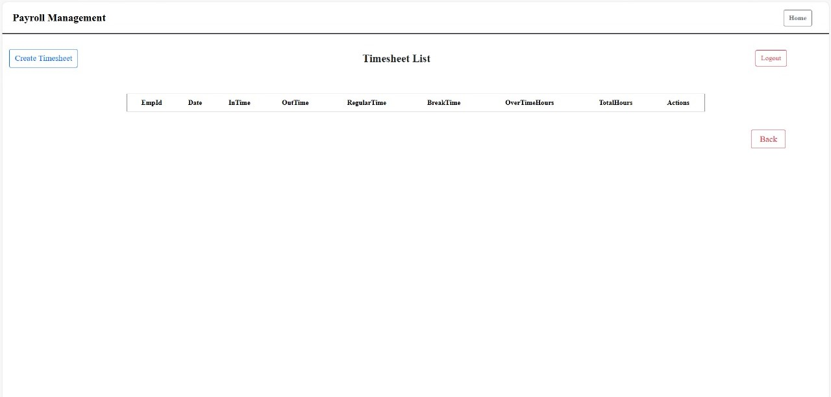

Slide 21
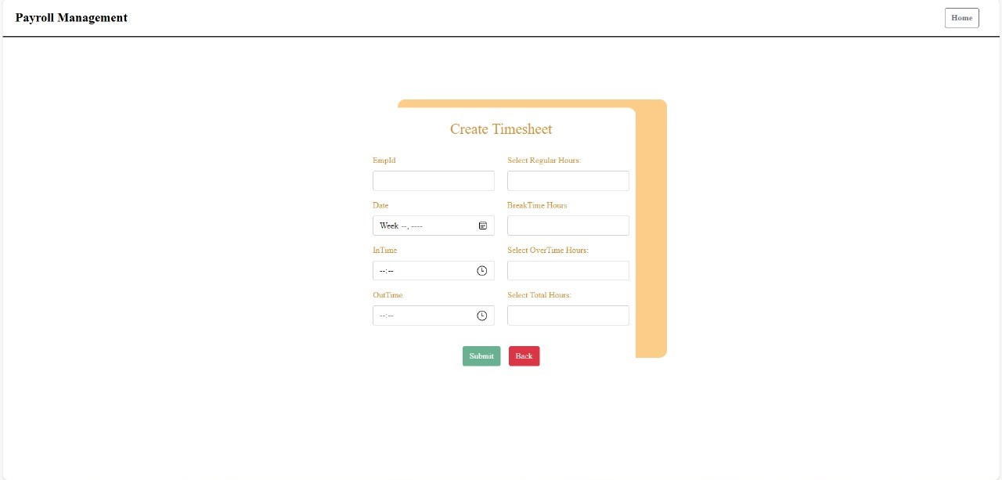

Slide 22

Add/edit/delete and view schedule work of employee
Streamline employee schedule management with our user-friendly system.
Effortlessly add, update, and delete schedules as required, ensuring smooth operations.
Gain a comprehensive view of work schedules, promoting optimal coordination.
Simplify workforce management and enhance productivity with ease.

Slide 23
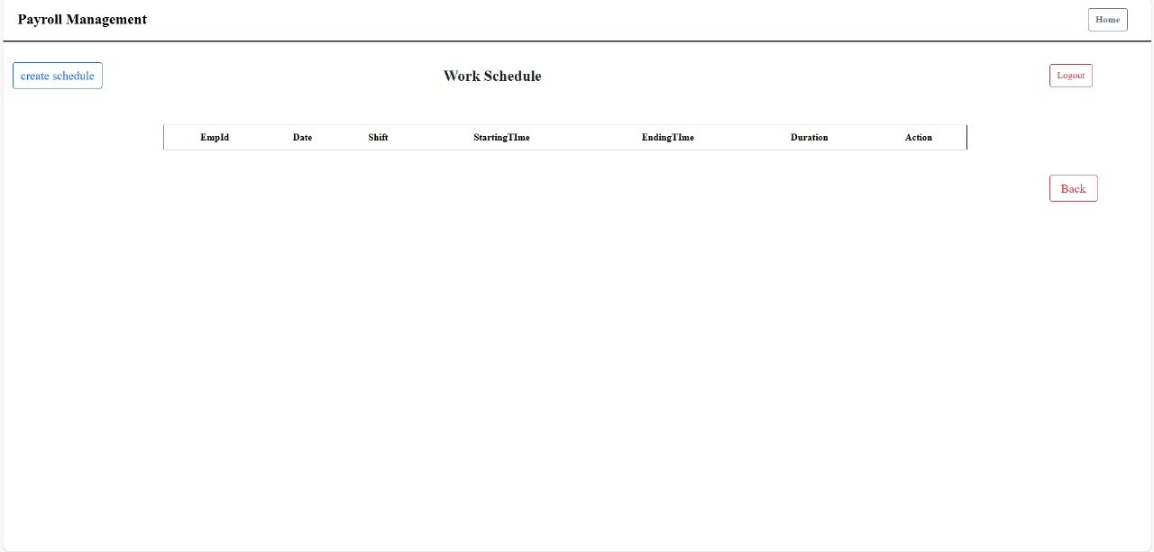

Slide 24
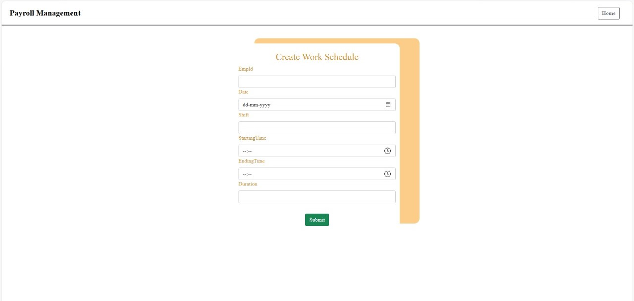

Slide 25

Apply/edit/delete and view leaves of employee
Apply: Adding leave records for employees is a breeze. Just input the dates and reason, and you're all set!
Edit: Need to make changes to leave dates? No problem! Easily edit leave records to match the new plans.
Delete: Plans changed? You can delete leave entries without any hassle, ensuring accurate records.
View: Get a quick overview of who's on leave and when. Stay organized and plan ahead effectively.

Slide 26
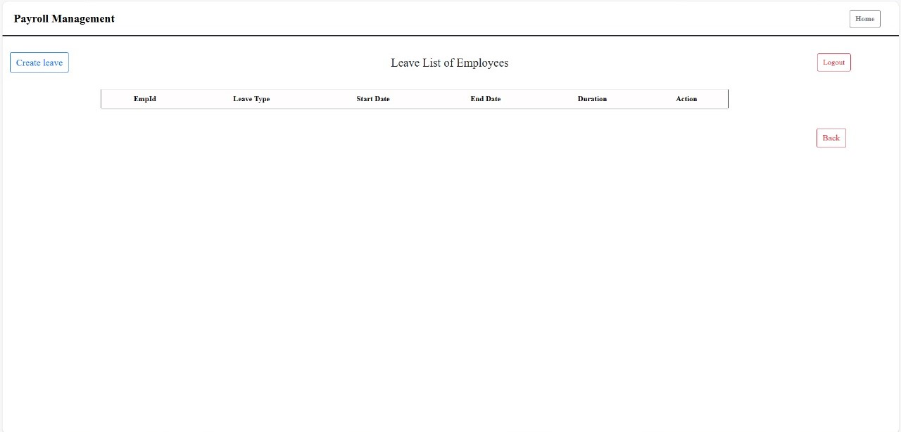

Slide 27
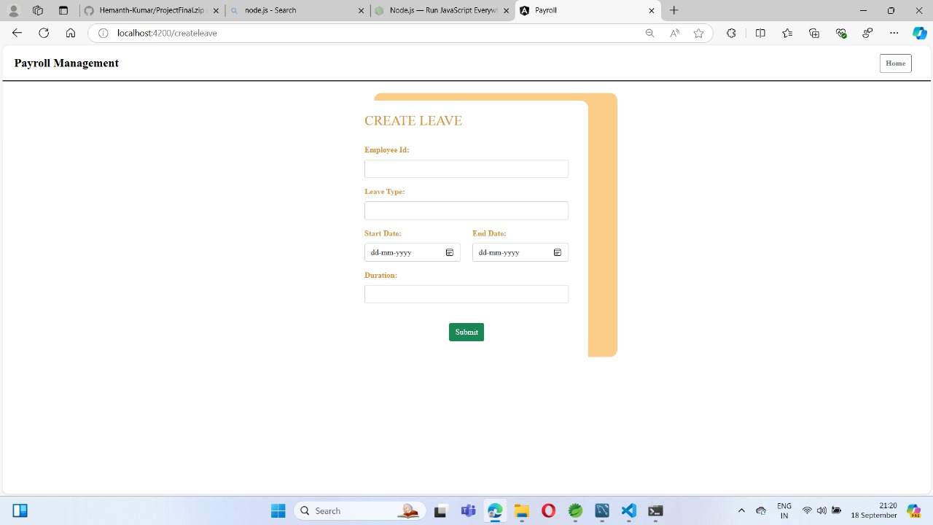

Slide 28

Add/edit and delete salary of employee
Add: Managing employee salaries is a breeze. Just input the details, and you're all set!
Edit: Need to make changes to salary figures? No problem! Easily edit salary records as needed.
Delete: Situations change? You can remove salary entries hassle-free, keeping records accurate.

Slide 29
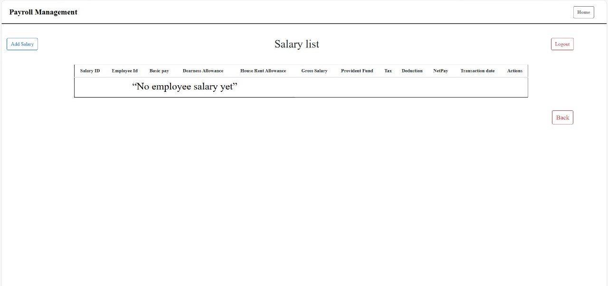

Slide 30
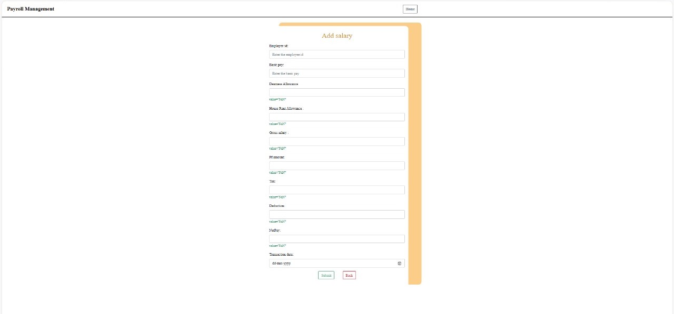

Slide 31
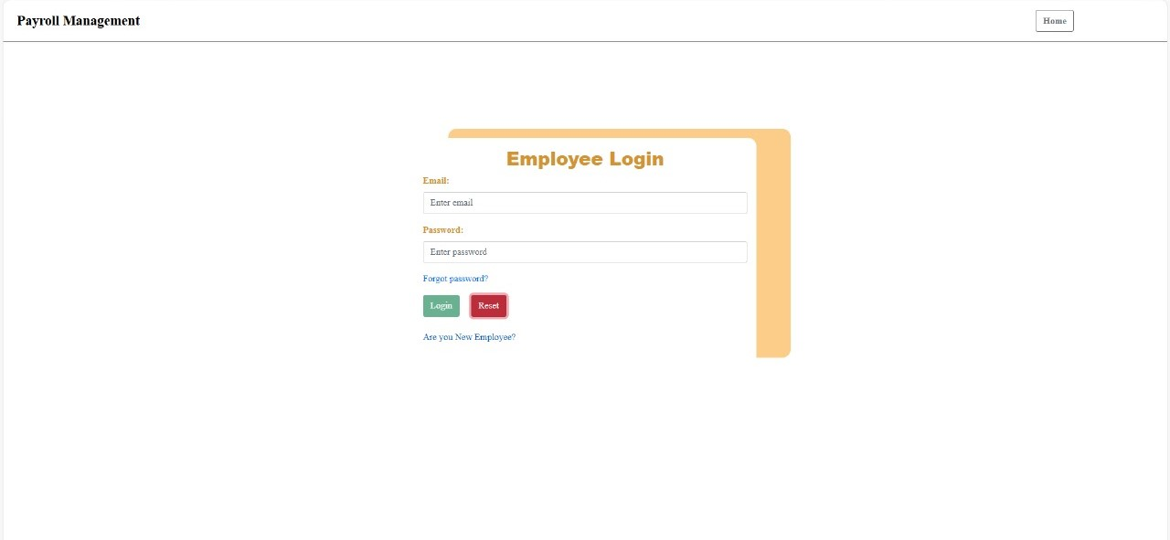

Slide 32
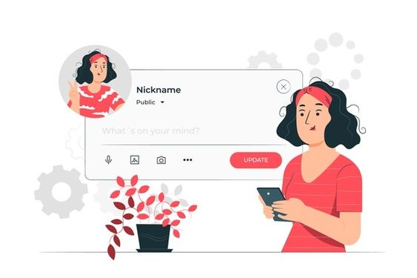
UPDATE PROFILE
Update profile :The admin and employee can view and update the profile.

Slide 33
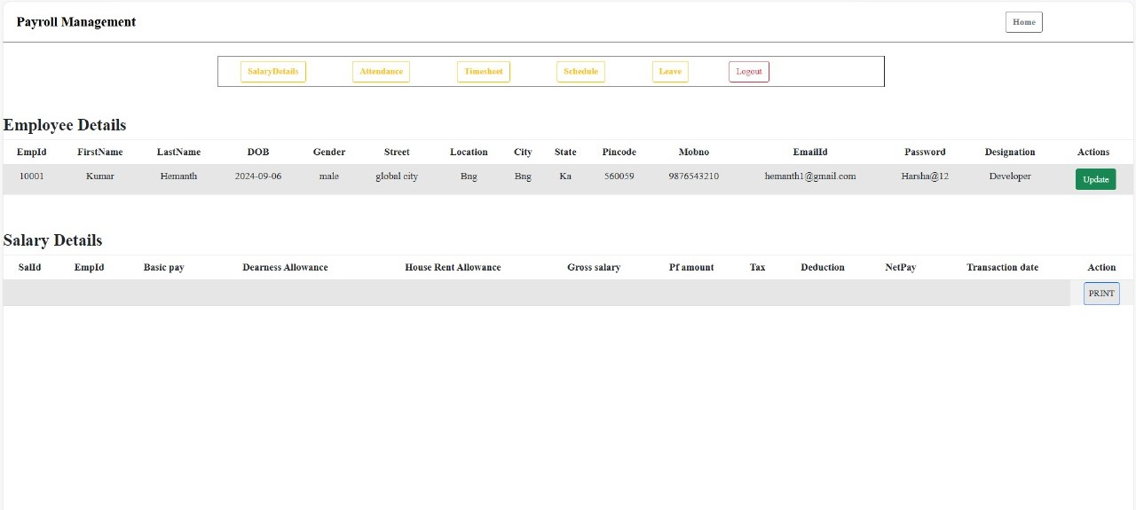

Slide 34
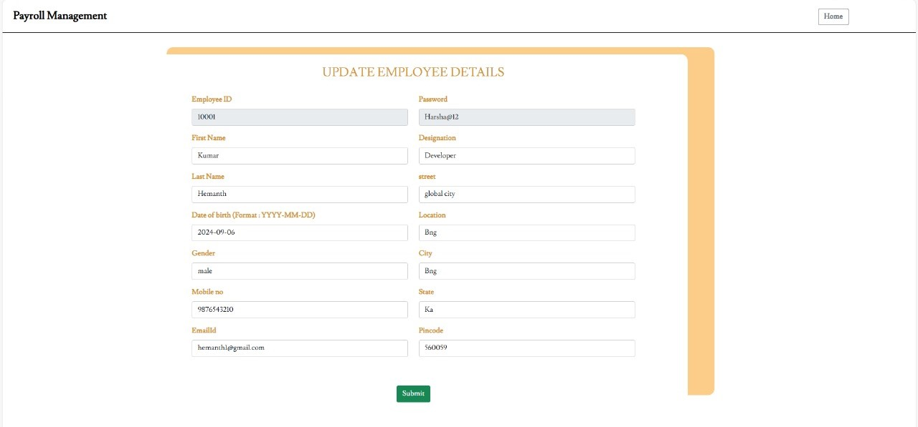

Slide 35
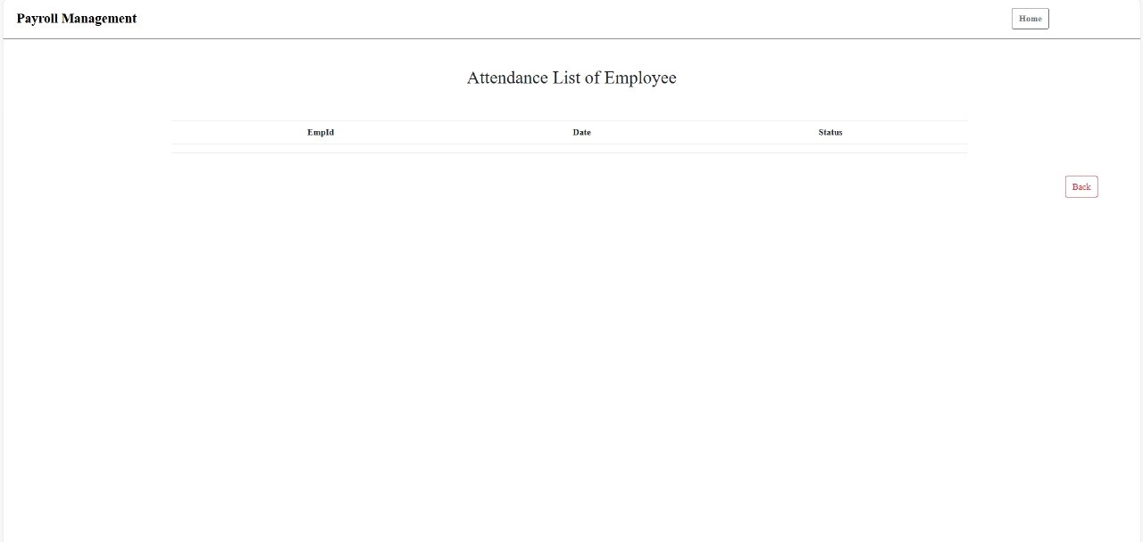

Slide 36
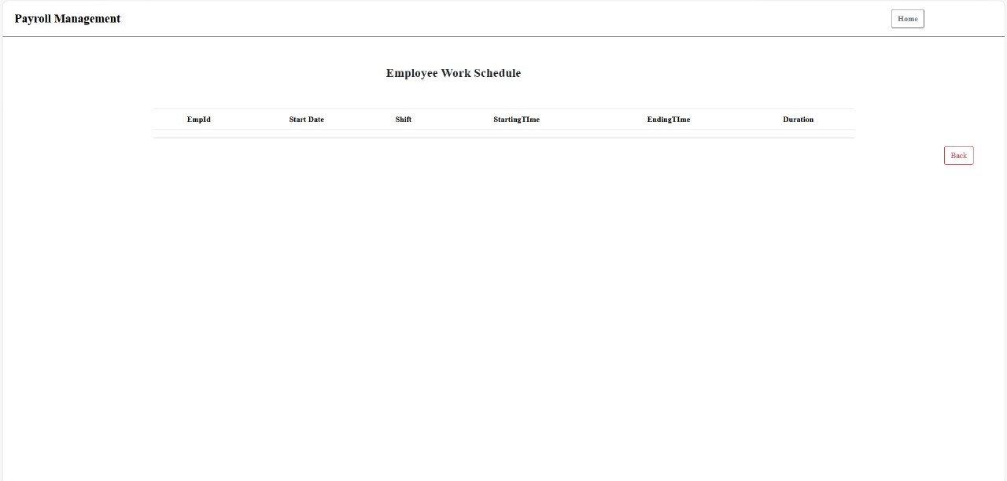

Slide 37
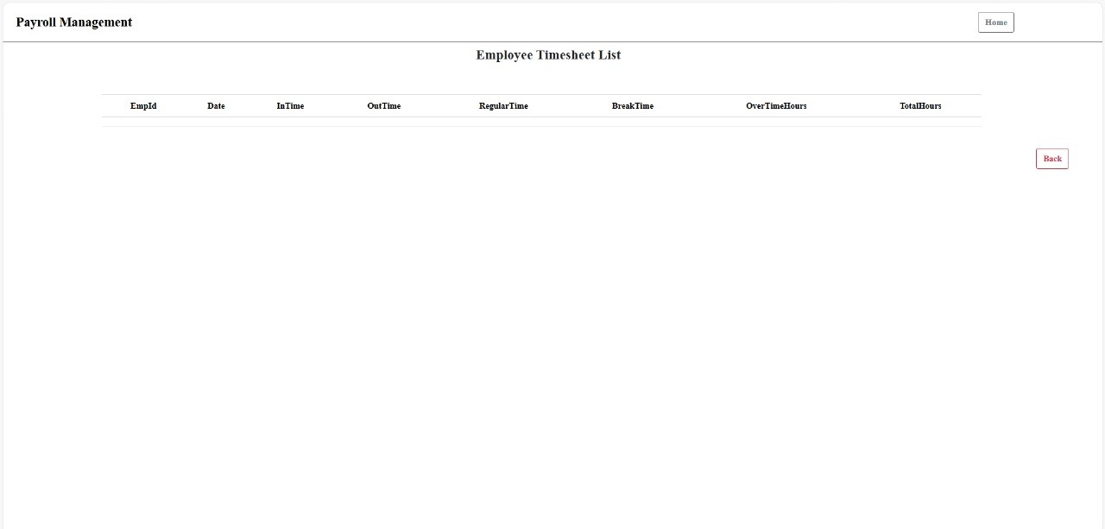

Slide 38
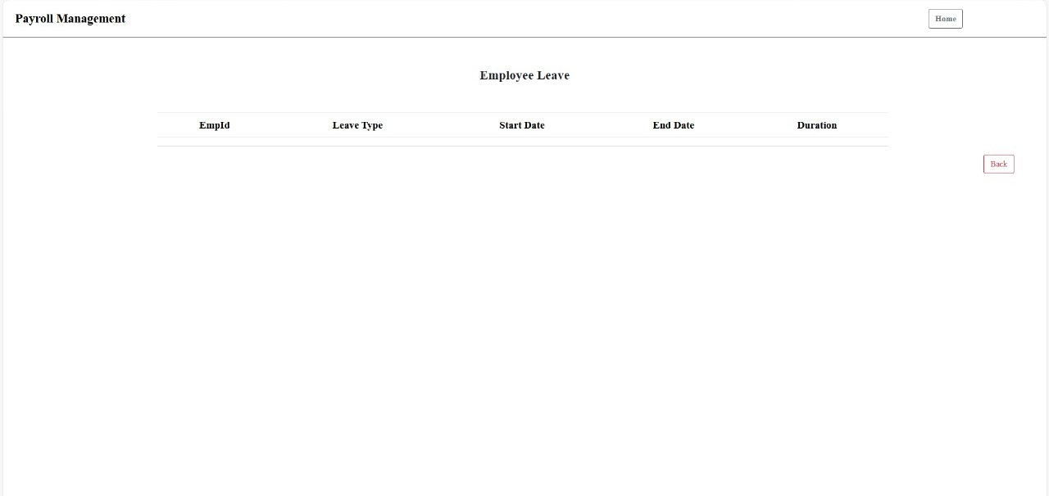

Slide 39

View and download salary slips of employee
View: Checking your salary details is hassle-free. Just a click away, and you can see your earnings.
Download: Need a copy? You can download your salary slip anytime you want.
User-Friendly: Our system is designed to make accessing salary slips simple and intuitive.
Self-Service: Empower employees by allowing them to access their own salary information.

Slide 40

conclusion
Our Project in a Nutshell:
This project is designed for both admin and employees in small organizations. It's perfect for workplaces with a limited number of team members. The admin has the power to add, update, and remove employee information. They can also handle adding new employees and setting pay grades. Admins can easily check records whenever they need to, with payment being on a monthly basis.
The project aims to make things easy and accurate. It saves time, cuts costs, and helps manage records effectively. It's a simple way to streamline processes and keep everything running smoothly.

Slide 41

THANK YOU

